Slide 1
Machine learning model determining the frog species of a given data SET

Slide 2
PROCEDURES INVOLVED
EXPLORATORY DATA ANALYSIS (EDA)
MACHINE LEARNING MODEL

Slide 3
EXPLORATORY DATA ANALYSIS
CONTINENTS NUMBER OF SPECIES
Australia 188020
Central America 3930
Africa 1840
Australia had the highest record of frog species when a value count was done on the merged data set.

Slide 4
EXPLORATORY DATA ANALYSIS CONTD…
FROG SPECIES NUMBER OF SPECIES
Crinia Signifera 126657
Litoria Fallax 47332
Crinia Glauerti 9393
Ranoidea Australis 4097
Agalychnis Callidryas 2212
Dendrobates Auratus 1717
Xenopus Laevis 1139
Chiromantis Xerampelina 702
Austrochaperina Pluvialis 541
From the value count analysis, Crinia Signifera was the most found species

Slide 5
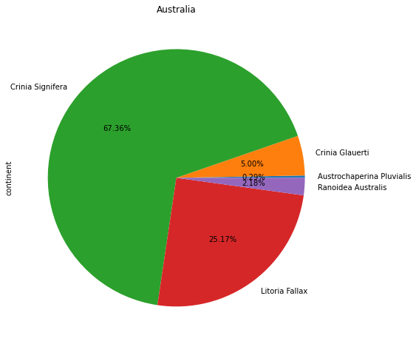
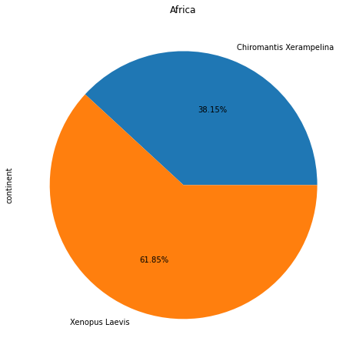
In Africa, the Chiromantis Xerampelina was the highest species recoreded and the xenopus laevis was the least recorded. Only two species were recorded in Africa
In Australia, the Crinia Signifera was the highest Species recorded and the Austrochaperina Pluvialis was the least species recorded

Slide 6
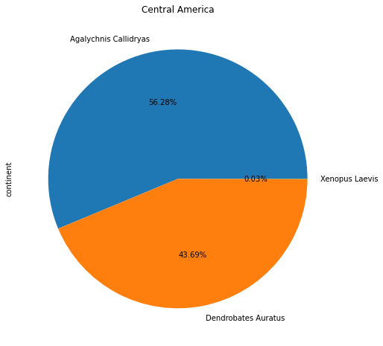
EDA CONTD…..
In Central America, the Agalychnis Callidryas was the highest species recorded and the Xenopus Laevis was the least recorded

Slide 7
MACHINE LEARNING MODEL
THE MODEL WAS SPLITED INTO THE TESTING AND LEARNING SET.
135653 ROWS ALONG WITH 8 COLUMNS WERE USED AS TRAINING SET AND 58137 ROWS AND 8 COLUMNS WERE USED AS THE TESTING SET
THE MODEL PROVED TO BE 93% ACCURATE WHICH IS GOOD

